Slide 1




GRADE 11 · ALGEBRA II · TOPIC 6
Lesson 6-6
Exponential and
Logarithmic Equations
and Inequalities
Journey of 6 stations, 60 minutes
Exponential and Logarithmic Functions
Mr Malek Thiab
FAITH, RIGHTEOUSNESS AND WISDOM
Notes:
Speaker notes: Welcome to Lesson 6-6: Exponential and
Logarithmic Equations and Inequalities.
Timing: 60 minutes (Diagnose 6, Targeted Instruction 18, Practice 12, Production 12, Mastery Gate 6, Smart Production 6). For a 40-minute class scale every station by two thirds.
The journey map on the next slide shows the six stations; in slideshow mode the Morph transition zooms the station circles into the breadcrumb at the top of every later slide.

Slide 2


Today's journey
Six stations. Each one zooms in as we arrive.
Targeted Instruction
18 min
Production
12 min
Smart Production
6 min
2
4
6
1
3
5
Diagnose
6 min
Practice
12 min
Mastery Gate
6 min
FAITH, RIGHTEOUSNESS AND WISDOM
Notes:
Speaker notes: This is the whole map. Walk it left to right: Diagnose (what we already know), Targeted Instruction (Exponential equations: match the bases; Exponential inequalities: check the base; Logarithmic equations: rules, then check; Use logarithms when the bases will not match), Practice (Practice, Apply, Investigate), Production (Red Sea resort visitor targets), Mastery Gate (three questions to pass), Smart Production (create, then Time to Check).
In slideshow mode the Morph transition animates these circles shrinking into the breadcrumb on later slides; without Morph the slides fade.
Ask the class which station they think will be hardest.

Slide 3
What we are learning
OBJECTIVES
VOCABULARY
Solve exponential equations and inequalities by applying the concept of a common base.
Solve logarithmic equations and inequalities by using the rules of logarithms.
Use logarithms to solve exponential equations and models.
exponential equation
exponential inequality
logarithmic equation
logarithmic inequality
STANDARDS
HSA.SSE.A.2 Use the structure of an expression to identify ways to rewrite it.
HSA.CED.A.1 Create equations and inequalities in one variable and use them to solve problems. Include equations arising from linear and quadratic functions, and simple rational and exponential functions.
HSA.REI.A.1 Explain each step in solving a simple equation as following from the equality of numbers asserted at the previous step, starting from the assumption that the original equation has a solution. Construct a viable argument to justify a solution method.
HSF.LE.A.4 For exponential models, express as a logarithm the solution to abᶜᵗ = d where a, c, and d are numbers and the base b is 2, 10, or e; evaluate the logarithm using technology.
ESSENTIAL QUESTION
How can we solve exponential and logarithmic equations and inequalities?
MATHEMATICAL PRACTICES MP.2 · MP.3
HSA.SSE.A.2 · HSA.CED.A.1 · HSA.REI.A.1 · HSF.LE.A.4
FAITH, RIGHTEOUSNESS AND WISDOM
Mr Malek Thiab · 3
Notes:
Speaker notes: Read the objectives aloud one at a time and have students say which one they feel least sure about.
Vocabulary used today: exponential equation, exponential inequality, logarithmic equation, logarithmic inequality.
Standards are listed on this slide.

Slide 4


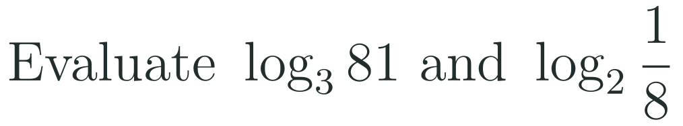
1
2
3
4
5
6
STATION 1 · DIAGNOSE · 6 MIN
Start here: three quick checks
1
2
3
Done when
All three answers are written without a calculator, and you can say why 2 to the power 4x is the same as 16 to the power x.
HSA.SSE.A.2 · HSA.CED.A.1 · HSA.REI.A.1 · HSF.LE.A.4
FAITH, RIGHTEOUSNESS AND WISDOM
Mr Malek Thiab · 4
Notes:
Speaker notes (Diagnose, 6 min, no calculator):
Answers. Q1: 125 = 5^3, so 5^x = 5^3 and x = 3. Q2: 16 = 2^4, so 16^x = (2^4)^x = 2^(4x). Q3: log_3(81) = 4 because 3^4 = 81; log_2(1/8) = -3 because 2^(-3) = 1/8. Verbal misconceptions: Q1 'divide 125 by 5' (x = 25); Q2 'multiply 16 by x' or writing 2^(16x), and forgetting to multiply the exponents in a power of a power; Q3 giving log_2(1/8) = 3 (sign error) or 'log_3 81 = 27'. Adaptive routing: if >30% miss Q1 or Q2, route to slide 5 (block 1) and start at Example A before anything else; if >30% miss Q3, spend 3 minutes on the meaning of a logarithm (log_b(c) is the exponent that b needs to make c) and then go to slide 7 (block 3). If 90% of the class gets all three right, go quickly through slide 5 and slide 6 and send them to Investigate.

Slide 5



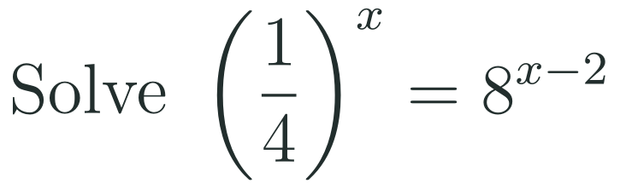








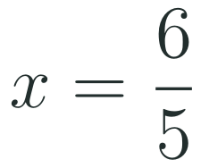
1
2
3
4
5
6
STATION 2 · TARGETED INSTRUCTION · 18 MIN
Exponential equations: match the bases
EXAMPLE A
EXAMPLE B
EXAMPLE C
HSA.SSE.A.2 · HSA.CED.A.1 · HSA.REI.A.1 · HSF.LE.A.4
FAITH, RIGHTEOUSNESS AND WISDOM
Mr Malek Thiab · 5
Notes:
Speaker notes (Targeted Instruction, block 1 of 4):
Worked solutions. Example A: 2^(x+1) = 32 and 32 = 2^5, so the bases match and the exponents are equal: x + 1 = 5, x = 4. Check: 2^5 = 32. Example B: 9 = 3^2 and 27 = 3^3, so 9^x = 3^(2x) and 27^(x-1) = 3^(3x-3); then 2x = 3x - 3 gives x = 3. Check: 9^3 = 729 and 27^2 = 729. Example C: (1/4)^x = (2^(-2))^x = 2^(-2x) and 8^(x-2) = 2^(3x-6); then -2x = 3x - 6 gives 5x = 6, x = 6/5. Check: both sides equal 2^(-12/5). Why it is allowed (HSA.REI.A.1): the exponential function with base b (b > 0, b not 1) is one-to-one, so b^m = b^n can only happen when m = n; say each step aloud as 'because the previous line says...'. Structure (HSA.SSE.A.2): see 9 as 3^2, see 1/4 as 2^(-2). Verbal misconceptions: 'multiply the exponents across' or 'divide the bases' (9^x = 27^(x-1) does not give 9x = 27(x-1)); not distributing the 3 in 3(x - 1), giving 3x - 1; writing 1/4 as 2^2 (sign of the exponent); equating exponents before the bases match. Adaptive routing: if >30% miss Diagnose Q1 or Q2, redo Example A with 5^(x+1) = 625 (x = 3) before Example B; if >30% cannot rewrite 1/4 as a power of 2, return to slide 4 Q2 and rebuild negative exponents; if >30% miss Example B, model 4^x = 8^(x-1) once more (4 = 2^2, 8 = 2^3, x = 3). Gate Q1 routes back to this slide (slide 5).

Slide 6

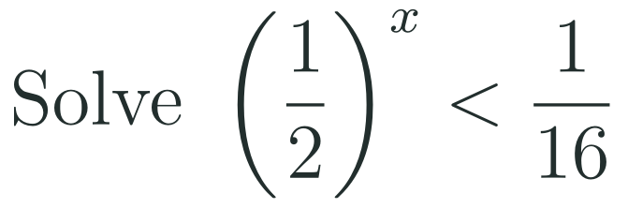
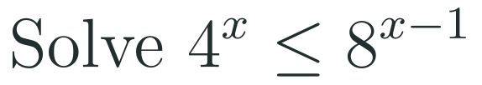

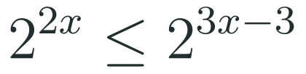

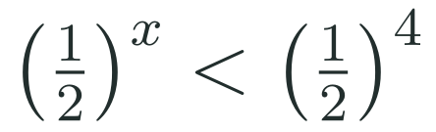





1
2
3
4
5
6
STATION 2 · TARGETED INSTRUCTION · 18 MIN
Exponential inequalities: check the base
EXAMPLE A
EXAMPLE B
EXAMPLE C
HSA.SSE.A.2 · HSA.CED.A.1 · HSA.REI.A.1 · HSF.LE.A.4
FAITH, RIGHTEOUSNESS AND WISDOM
Mr Malek Thiab · 6
Notes:
Speaker notes (Targeted Instruction, block 2 of 4):
Worked solutions. Example A: 27 = 3^3 and the base 3 is greater than 1, so the direction stays: 2x - 1 > 3, x > 2. Check: x = 3 gives 3^5 = 243 > 27 (true); x = 1 gives 3^1 = 3 > 27 (false). Example B: 1/16 = (1/2)^4. The base 1/2 is between 0 and 1, so the exponential function is DECREASING and the inequality flips: x > 4. Check: x = 5 gives 1/32 < 1/16 (true); x = 3 gives 1/8 < 1/16 (false). Example C: 4 = 2^2 and 8 = 2^3, base 2 is greater than 1: 2x <= 3x - 3 gives -x <= -3, so x >= 3 (dividing by -1 flips, a second flip that students forget). Check: x = 3 gives 64 <= 64 (true, so 3 is included); x = 2 gives 16 <= 8 (false). Say aloud: a bigger exponent means a bigger value only when the base is bigger than 1. Verbal misconceptions: never flipping for a base between 0 and 1; flipping every time (even with base 3); flipping when moving terms across but forgetting the flip when dividing by a negative; writing x > 4 as x < 4 by reading the inequality in the wrong direction. Adaptive routing: if >30% fail to flip in Example B, test x = 5 and x = 3 together in the original inequality; if >30% miss Example C, replay the line 2x <= 3x - 3 and subtract 3x slowly; if >30% miss Apply 1 later, return to this slide (slide 6). Gate Q3 routes back to this slide.

Slide 7


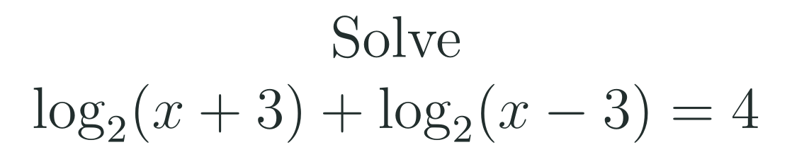
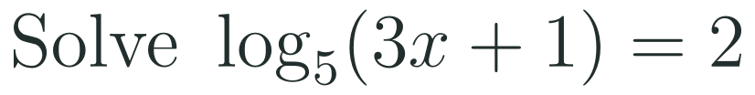
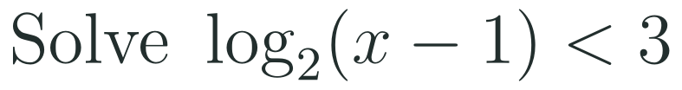


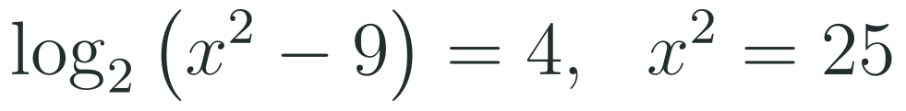




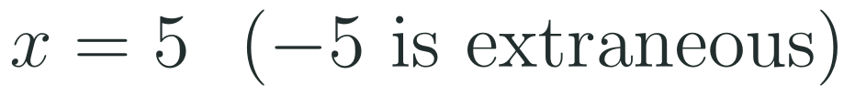
1
2
3
4
5
6
STATION 2 · TARGETED INSTRUCTION · 18 MIN
Logarithmic equations: rules, then check
EXAMPLE A
EXAMPLE B
EXAMPLE C
HSA.SSE.A.2 · HSA.CED.A.1 · HSA.REI.A.1 · HSF.LE.A.4
FAITH, RIGHTEOUSNESS AND WISDOM
Mr Malek Thiab · 7
Notes:
Speaker notes (Targeted Instruction, block 3 of 4):
Worked solutions. Example A: the arguments must be positive, so x + 3 > 0 and x - 3 > 0, which gives x > 3. Combine with the product rule: log_2((x+3)(x-3)) = log_2(x^2 - 9) = 4. Convert to exponential form: x^2 - 9 = 2^4 = 16, so x^2 = 25 and x = 5 or x = -5. Test the domain x > 3: x = 5 works (log_2 8 + log_2 2 = 3 + 1 = 4), x = -5 makes x + 3 = -2 and x - 3 = -8, so the logarithms do not exist: -5 is an EXTRANEOUS solution. Example B: log_5(3x+1) = 2 means 3x + 1 = 5^2 = 25, so x = 8. Check: 3(8) + 1 = 25 > 0 and log_5 25 = 2. Example C: log_2(x-1) < 3 needs two conditions. Domain: x - 1 > 0. Inequality: the base 2 is greater than 1, so the direction stays: x - 1 < 2^3 = 8. Together 0 < x - 1 < 8, so 1 < x < 9. Check: x = 5 gives log_2 4 = 2 < 3 (true); x = 0 or x = 10 fail (not in the domain, or log_2 9 > 3). For a base between 0 and 1 the inequality flips: log_(1/2)(x) > 2 gives 0 < x < 1/4. Verbal misconceptions: keeping x = -5 because the quadratic gave it; 'the log of a negative is a negative number'; forgetting the domain condition in an inequality and answering x < 9; splitting log(x+3) + log(x-3) as log(2x). Adaptive routing: if >30% keep x = -5 in Example A, stay and test both candidates in the ORIGINAL equation on the board; if >30% cannot convert log form to exponential form, go to slide 4 Q3; if >30% miss Example C, redo it with the number line showing domain and inequality as two overlapping conditions. Gate Q2 routes back to this slide (slide 7).

Slide 8



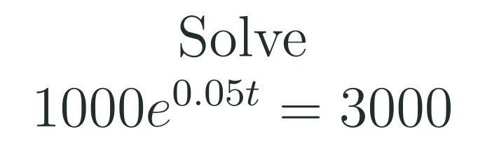



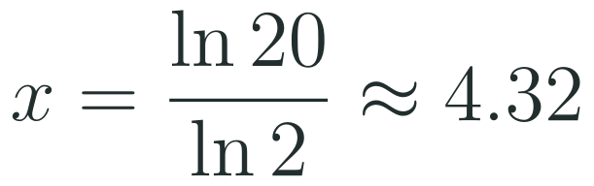

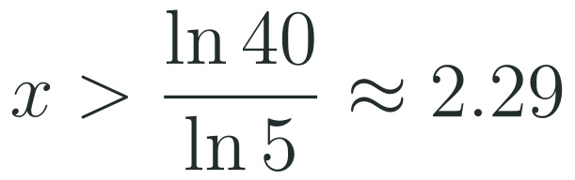

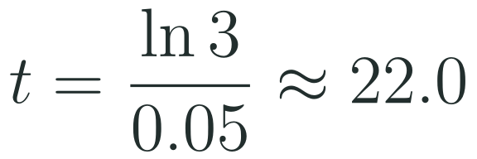
1
2
3
4
5
6
STATION 2 · TARGETED INSTRUCTION · 18 MIN
Use logarithms when the bases will not match
EXAMPLE A
EXAMPLE B
EXAMPLE C
HSA.SSE.A.2 · HSA.CED.A.1 · HSA.REI.A.1 · HSF.LE.A.4
FAITH, RIGHTEOUSNESS AND WISDOM
Mr Malek Thiab · 8
Notes:
Speaker notes (Targeted Instruction, block 4 of 4):
Worked solutions (calculator allowed here). Example A: 20 is not a power of 2, so use the logarithm: 2^x = 20 means x = log_2(20) = ln(20)/ln(2) = 2.9957/0.6931, about 4.32. Check: 2^4.32 is about 20. Example B (exponential model, HSF.LE.A.4 with base e): divide by 1000: e^(0.05t) = 3; take ln of both sides: 0.05t = ln 3 = 1.0986; t = 1.0986/0.05 = 21.97, about 22.0 years. Example C: 5^x > 40 means x > log_5(40) = ln 40 / ln 5 = 3.6889/1.6094, about 2.29; the base 5 is greater than 1, so the direction stays. Check: 5^2.3 is about 40.4, which is greater than 40. Keep the exact form first, decimal second. Verbal misconceptions: 'ln(20)/ln(2) = ln(10)' (dividing the arguments); 'x = 20/2 = 10'; forgetting to divide by 0.05 or dividing the wrong way (multiplying by 0.05); rounding ln 3 early; writing log_2(20) = log(20) / 2. Adaptive routing: if >30% give x = 10 in Example A, return to slide 4 Q3 and the meaning of a logarithm; if >30% miss the division by 0.05, replay Example B step by step; if >30% cannot choose between matching bases and using logarithms, ask 'is 20 a power of 2?' and route to slide 5 for the matching case. Production Task 1 routes back to this slide (slide 8).

Slide 9

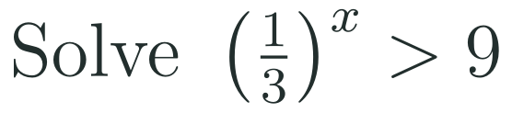
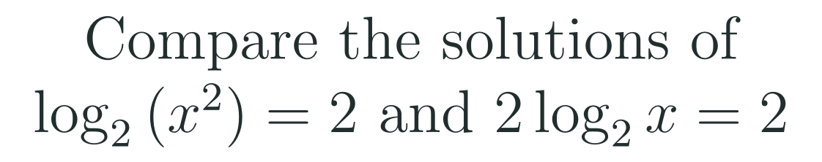
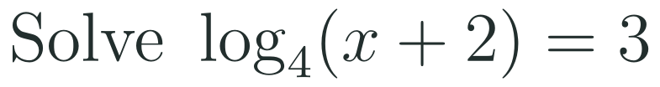
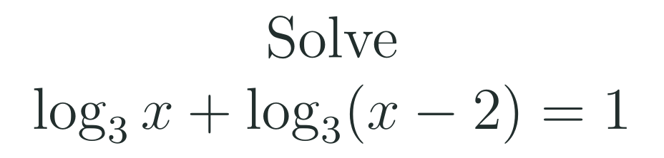
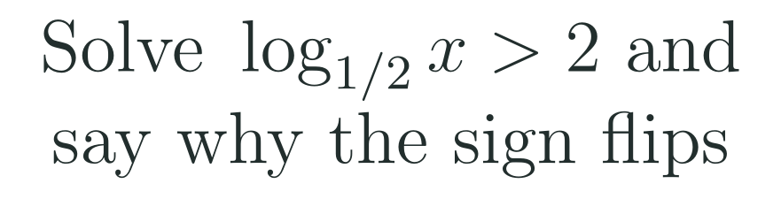
1
2
3
4
5
6
STATION 3 · PRACTICE · 12 MIN
Give it a go: Practice, Apply, Investigate
PRACTICE
APPLY
INVESTIGATE
Secure the method
Use it in context
Find out why
Done when: both sides share one base before the exponents are equated, and each logarithm answer is checked in the original equation.
Done when: the direction of the inequality is justified by the size of the base, and each logarithm solution is tested against the domain.
Done when: your explanation uses the domain of the logarithm, and you test your inequality with one value inside and one outside your answer.
HSA.SSE.A.2 · HSA.CED.A.1 · HSA.REI.A.1 · HSF.LE.A.4
FAITH, RIGHTEOUSNESS AND WISDOM
Mr Malek Thiab · 9
Notes:
Speaker notes (Practice, 12 min; tierless differentiation: students choose the starting column and may move across):
Answers. Practice 1: 81 = 3^4, so x - 2 = 4 and x = 6. Check: 3^4 = 81. Practice 2: log_4(x+2) = 3 means x + 2 = 4^3 = 64, so x = 62. Check: log_4(64) = 3. Apply 1: (1/3)^x > 9; 9 = 3^2 and (1/3)^x = 3^(-x), so -x > 2 and x < -2 (base 3 is greater than 1, and dividing by -1 flips). Check: x = -3 gives 27 > 9 (true); x = -1 gives 3 > 9 (false). Apply 2: domain x > 2; product rule: log_3(x(x-2)) = 1, so x^2 - 2x = 3, x^2 - 2x - 3 = 0, (x - 3)(x + 1) = 0, x = 3 or x = -1; x = -1 fails the domain, so x = 3. Check: log_3 3 + log_3 1 = 1 + 0 = 1. Investigate 1: log_2(x^2) = 2 gives x^2 = 4, x = 2 or x = -2, and both work because x^2 is positive (log_2(4) = 2). But 2 log_2(x) = 2 needs x > 0, so only x = 2. The two equations have different domains: the power rule 'log(x^2) = 2 log x' is only valid for x > 0. Investigate 2: log_(1/2)(x) > 2 needs x > 0; (1/2)^2 = 1/4; the function log_(1/2) is DECREASING (base below 1), so the sign flips: 0 < x < 1/4. Test: x = 1/8 gives 3 > 2 (true); x = 1/2 gives 1 > 2 (false). Verbal misconceptions: Practice 2 answering 12 (3 x 4) or 64; Apply 1 forgetting to flip, x > -2; Apply 2 keeping x = -1; Investigate 1 'both equations are the same'. Adaptive routing: if >30% miss Practice 1, route to slide 5 Example A; Practice 2, slide 7 Example B; Apply 1, slide 6 Example B; Apply 2, slide 7 Example A; Investigate 1, slide 7 and the domain; Investigate 2, slide 6 then slide 7 Example C. Students who finish Apply early move to Investigate.

Slide 10
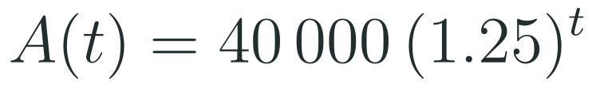
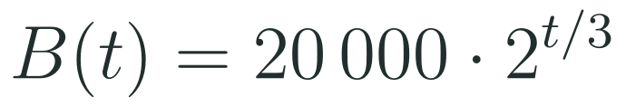
1
2
3
4
5
6
STATION 4 · PRODUCTION · 12 MIN
Production: Red Sea resort visitor targets
THE MODEL
DONE WHEN
Vision 2030 includes new Red Sea tourism resorts. Using model values only (not forecasts), two resorts are modelled by the visitors-per-year functions below, with time measured in years after opening. The tourism board wants to know when each resort reaches its targets.
Task 1 is written as a logarithm first and evaluated: about 5.1 years.
Task 2 gives a time above about 7.2 years, so 8 whole years, with the inequality direction kept.
Task 3 matches bases for Resort B: the exponent must equal 3, giving 9 years.
The comparison says Resort A is first: about 6.2 years against 9 years.
Find when Resort A reaches 125 000 visitors: write it as a logarithm first, then give the time to 1 decimal place.
Find when Resort A first exceeds 200 000 visitors, and say how many whole years are needed.
Use a common base to find when Resort B reaches 160 000; then find when Resort A does, and say which resort is first.
Hint for solving: if the bases cannot be matched, take the natural logarithm of both sides; if they can, match them.
HSA.SSE.A.2 · HSA.CED.A.1 · HSA.REI.A.1 · HSF.LE.A.4
FAITH, RIGHTEOUSNESS AND WISDOM
Mr Malek Thiab · 10
Notes:
Speaker notes (Production, 12 min):
Model values only, not forecasts. Task 1: 40000(1.25)^t = 125000, so (1.25)^t = 3.125 = 25/8. Then t = log_1.25(3.125) = ln(3.125)/ln(1.25) = 1.1394/0.2231 = 5.106, about 5.1 years. Check: 40000 x 1.25^5.106 = 125000. Task 2: 40000(1.25)^t > 200000, so (1.25)^t > 5 and t > ln5/ln1.25 = 1.6094/0.2231 = 7.21 (base 1.25 is greater than 1, so the sign stays). A(7) = 190 735 is below 200 000 and A(8) = 238 419 is above it, so 8 whole years are needed. Task 3: B(t) = 160000 gives 2^(t/3) = 8 = 2^3, so t/3 = 3 and t = 9 years (common base, no calculator). For Resort A: (1.25)^t = 4, t = ln4/ln1.25 = 1.3863/0.2231 = 6.21 years. 6.2 is less than 9, so Resort A reaches 160 000 first. Verbal misconceptions: dividing 125000 by 40000 and forgetting that this is a ratio of 3.125, not t; answering 7 for Task 2 (rounding down: A(7) is still below target); writing t/3 = 8 and getting t = 24 (forgetting to match the bases first); comparing 6.2 and 9 the wrong way. Adaptive routing: if >30% cannot start Task 1, go back to slide 8 Example B (the e-model pattern); if >30% miss Task 2, go to slide 6 (inequality direction) and slide 8 Example C; if >30% miss Task 3, go to slide 5 Example B. Early finishers: find when Resort B first exceeds 200 000 (2^(t/3) > 10, t > 9.97, so 10 whole years).

Slide 11

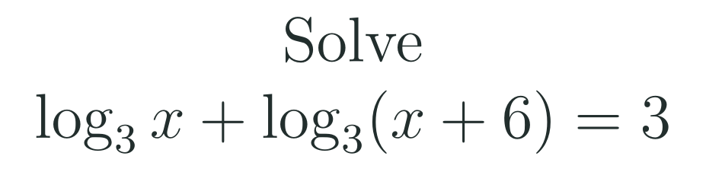
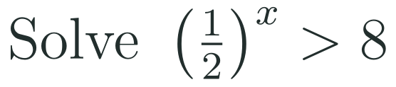
1
2
3
4
5
6
STATION 5 · MASTERY GATE · 6 MIN
Mastery Gate: three questions to pass
1
2
3
Pass mark
3 of 3 correct unlocks Station 6. Fewer than that: return to the slide for the question you missed, redo it, then re-take the gate.
HSA.SSE.A.2 · HSA.CED.A.1 · HSA.REI.A.1 · HSF.LE.A.4
FAITH, RIGHTEOUSNESS AND WISDOM
Mr Malek Thiab · 11
Notes:
Speaker notes (Mastery Gate, 6 min, no calculator):
Answers. Q1: 4 = 2^2 and 8 = 2^3, so 2^(2x+2) = 2^(3x); 2x + 2 = 3x; x = 2. Check: 4^3 = 64 = 8^2. Q2: domain x > 0; x(x+6) = 3^3 = 27, x^2 + 6x - 27 = 0, (x + 9)(x - 3) = 0, x = 3 or x = -9; x = -9 fails the domain, so x = 3. Check: log_3 3 + log_3 9 = 1 + 2 = 3. Q3: 8 = 2^3 and (1/2)^x = 2^(-x), so -x > 3 and x < -3. Check: x = -4 gives 16 > 8 (true); x = -2 gives 4 > 8 (false). Verbal misconceptions: Q1 'x + 1 = x' by dividing the bases, or 2x + 2 = 3x solved as x = -2; Q2 keeping x = -9, or 3 x 3 = 9 for the right-hand side; Q3 answering x > -3 (not flipping) or x < 3 (sign slip on the exponent). Adaptive routing: Q1 missed, route to slide 5 (block 1); Q2 missed, route to slide 7 (block 3); Q3 missed, route to slide 6 (block 2). If a student misses two or more, they join the teacher group for the Smart Production create step; students who get all three correct start the create step immediately.

Slide 12
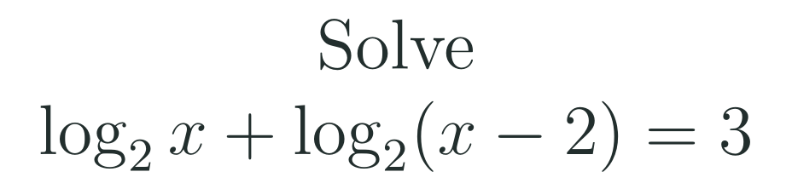
1
2
3
4
5
6
STATION 6 · SMART PRODUCTION · 6 MIN
Smart Production: make one, then check it
CREATE
TIME TO CHECK
Write one logarithmic equation whose algebra gives two candidate solutions, where exactly one is valid.
Write the full solution on the back, with the domain check and the rejected value.
Swap with a partner and solve theirs.
Exit ticket: write your answer on a sticky note and place it on the door.
Done when: your equation has exactly one valid solution, and your solution shows the domain check and one test by substitution.
Next lesson: 6-7 Geometric Sequences and Series.
HSA.SSE.A.2 · HSA.CED.A.1 · HSA.REI.A.1 · HSF.LE.A.4
FAITH, RIGHTEOUSNESS AND WISDOM
Mr Malek Thiab · 12
Notes:
Speaker notes (Smart Production, 6 min):
Worked solutions. Exit 1: domain x > 2; x(x-2) = 2^3 = 8, x^2 - 2x - 8 = 0, (x - 4)(x + 2) = 0, x = 4 or x = -2; x = -2 fails the domain, so x = 4. Check: log_2 4 + log_2 2 = 2 + 1 = 3. Exit 2: 7^x = 30 gives x = ln30/ln7 = 3.4012/1.9459 = 1.7479, so x = 1.75 to 3 s.f. Check: 7^1.75 is about 30.1. Create step: a good equation looks like log_2(x + a) + log_2(x - a) = c, which gives x^2 = a^2 + 2^c and one negative candidate; check that the partner can find exactly one valid solution. Verbal misconceptions: Exit 1 keeping -2, or writing log_2(x) + log_2(x-2) = log_2(2x - 2); Exit 2 writing x = 30/7 or ln(30/7). Adaptive routing: if >30% miss exit 1, begin 6-7 with a ten-minute recap of slide 7 Example A; if >30% miss exit 2, open with slide 8 Example A.

Slide 13
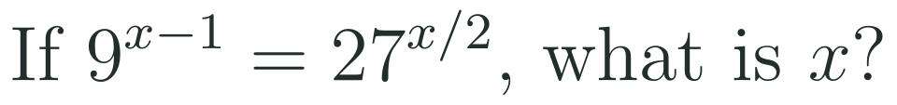

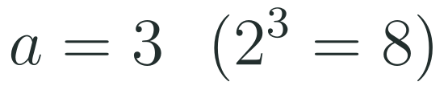
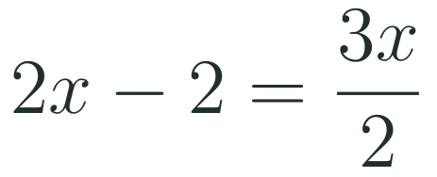
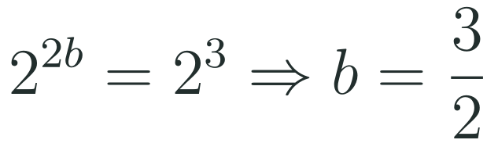

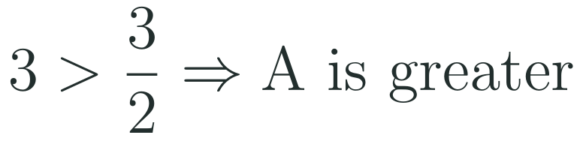

Exam connections
SAT
GAT
SAAT
STEPS
STEPS
STEPS
1
1
1
2
2
2
3
3
3
HSA.SSE.A.2 · HSA.CED.A.1 · HSA.REI.A.1 · HSF.LE.A.4
FAITH, RIGHTEOUSNESS AND WISDOM
Mr Malek Thiab · 13
Notes:
Speaker notes: each exam item is worked in numbered steps.
SAT (Advanced Math, global style): 9 = 3^2 and 27 = 3^3, so 3^(2(x-1)) = 3^(3x/2); the exponents are equal: 2x - 2 = 3x/2; multiply by 2: 4x - 4 = 3x; x = 4. Check: 9^3 = 729 = 27^2. Trap: equating 9 and 27 bases without converting, or distributing 2(x - 1) as 2x - 1 (partial step); the wrong option x = -4 comes from a sign slip. GAT/Qudurat quantitative comparison: A = 3 because 2^3 = 8; B: 4^b = 2^(2b) = 2^3 so b = 3/2; 3 is greater than 3/2, so A is greater. Trap: assuming both quantities are equal because both equations equal 8, or computing b = 2 from 4^2 = 16 wrongly. SAAT/Tahsili: x(x - 1) = 2^1 = 2, x^2 - x - 2 = 0, (x - 2)(x + 1) = 0; the domain needs x > 0 and x - 1 > 0, so x > 1: x = 2 only. Trap: keeping x = -1 (extraneous). Adaptive routing: if >30% miss the SAT item, return to slide 5 Example B; the GAT item, slide 5 Example C; the SAAT item, slide 7 Example A.

Slide 14
Journey complete
Targeted Instruction
Production
Smart Production
✓
✓
✓
✓
✓
✓
Diagnose
Practice
Mastery Gate
To solve an exponential equation, match the bases or take a logarithm; to solve a logarithmic equation, use the rules and then check every answer in the domain; flip an inequality only when the base is below 1.
FAITH, RIGHTEOUSNESS AND WISDOM
Notes:
Speaker notes: Every station is checked off. Recap in one sentence: To solve an exponential equation, match the bases or take a logarithm; to solve a logarithmic equation, use the rules and then check every answer in the domain; flip an inequality only when the base is below 1. Collect the Time to Check responses. Next lesson: 6-7 Geometric Sequences and Series.

